Slide 1
Gen AI With RAG Pattern
March 2025

Slide 2
Background and Context
Sydney Water has recently created an Artificial Intelligence (AI) Blueprint as a guide to ensure AI is leveraged in a safe and ethical manner across the organisation
AI Blueprint identified several promising opportunities for enhancing business performance, environmental outcomes, and customer and community engagement
As part of an initiative to formalise the Enterprise AI framework and governance, three small scale AI products have been chosen form the identified use cases for initial delivery
This deck aims to discuss a new architecture pattern necessary for delivering a chatbot, one of those three prioritised AI products and seek endorsement of that new pattern. This will be run as a pilot for assessing the capability and feasibility of adopting it for other GenAI use cases.

Slide 3
AI Product Summary
The following table provides a summary of the 3 prioritised AI products along with the architecture patterns necessary for delivering them
AI Products | Data Sources & Classification | Reference Architecture AI Pattern
Sydney Water Chatbot - AI tool to read and learn from HR policies and present the data to the user in a simulated human conversation format | HR Policy Documents (Official) Enterprise Agreement (Official) | A new pattern required as the use case is about responding to natural language inputs and engaging with users in a human-like manner
Leak/Anomaly Detection (MNF) - ML Model that detects anomalies in the minimum night flow at zone level resulting in optimal leak detection in our network ahead of time before they result in costly losses | IICATS (Protected) Maximo (Official) | Machine Learning Modelling on Azure Databricks (Endorsed pattern)
Asset health (Vent shaft) - ML Model that identifies and predicts vent shaft failure likelihood allowing for timely maintenance and reduced unplanned downtime | IICATS (Protected) Maximo (Official) Hydra (Official) Documents from SWIMs and BMIS (including asset information, program information, work instructions) Mapinfo (not in EDP currently) | Machine Learning Modelling on Azure Databricks (Endorsed pattern)

Slide 4
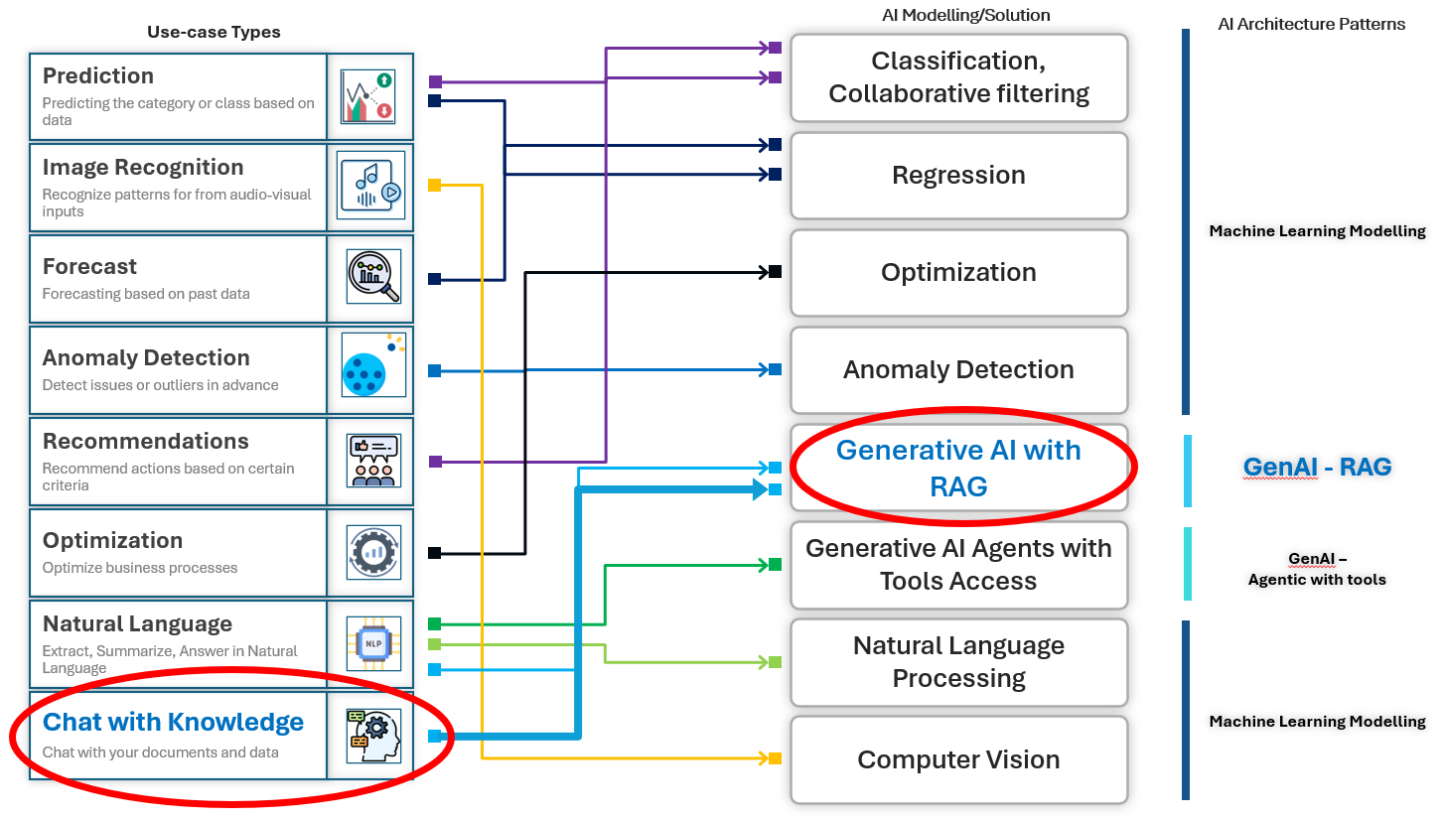
AI Use-case Types & Architecture Pattern Mapping from AI Blueprint
The AI Blueprint mapped the use case types with the AI architecture patterns as shown in the mapping below. Sydney Water Chatbot is a chat with knowledge (our documents) type of use case and the right AI modelling technique for those use cases is Generative AI with RAG.

Slide 5
Bespoke GenAI vs M365 Copilot
 | Bespoke GenAI Solution | M365 Copilot
Use Cases | Wide variety of use cases (eg: complex document analysis, integration with enterprise applications, unique data sources and workflows) | Limited to M365 scenarios (eg: day to day document creation, summarization, emails etc.)
Data scope / Data sources | Any data sources and enterprise systems with custom integrations | M365 stack/Microsoft Graph and linked data sources only
Integrations | Integration possible with any enterprise application and workflows | Limited to M365 Stack/Microsoft Graph
LLMs/FMs Choice | LLMs/FMs can be chosen based on best available | Default models used by M365 only
Customization / Innovation | Customizable and extendable use cases based on unique business scenarios | Limited by M365 scenarios, limited customization
Advanced Future Capabilities | Can incorporate fine-tuning or AI Agents at a later state if required | Limited by M365 Copilot product roadmap

Slide 6
Retrieval Augmented Generation (RAG)
User submits a query
System retrieves relevant information from knowledge sources
Retrieved context augments the AI prompt
AI generates accurate, contextual responses

Slide 7
GenAI with RAG on Databricks – Mosaic AI Tools
The following table lists various tools that Databricks Mosaic AI provides to help build GenAI solutions
Component | Task
Unity Catalog | Governance, discovery, versioning, and access control for data, features, models, and functions.
Mosaic AI Vector Search | Queryable vector database that stores embedding vectors and can be configured to automatically sync to our documents
Mosaic AI Model Serving | Deploying LLMs. We can configure a model serving endpoint specifically for accessing generative AI models. Requires Databricks Serverless for Python
Mosaic AI Agent Framework | Building and deploying production-quality agents like Retrieval Augmented Generation (RAG) applications
Mosaic AI Agent Evaluation | Evaluating the quality, cost, and latency of generative AI applications, including RAG applications and chains
Mosaic AI Gateway | Governing and monitoring access to supported generative AI models and their associated model serving endpoints
AI Playground | Testing generative AI models from our Databricks workspace. We can prompt, compare and adjust settings such as system prompt and inference parameters
Lakehouse Monitoring | Data monitoring and tracking model prediction quality and drift using automatic payload logging with inference tables.

Slide 8
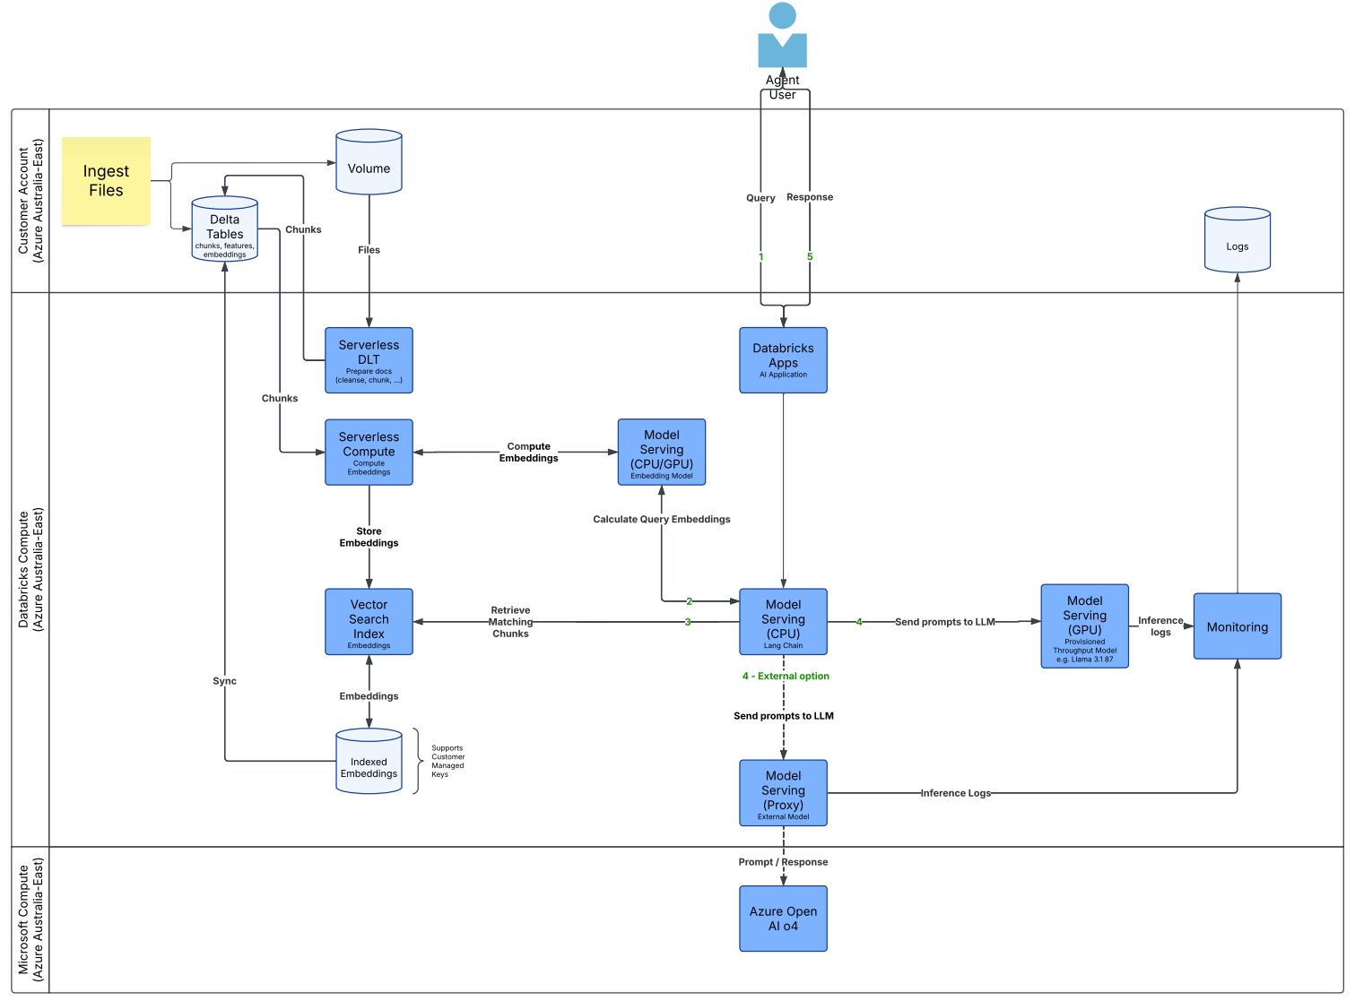
Gen AI with RAG on Databricks
Tools and capabilities required:
Databricks Mosaic AI (LLMs, Model Serving, Vector Search Database, AI Gateway)
Databricks Apps (AI serving platform)
Databricks Serverless for Python
Vector Database is in Databricks Tenancy
Every customer request to Mosaic AI Vector Search is logically isolated, authenticated, and authorized.
Mosaic AI Vector Search encrypts all data at rest (AES-256) and in transit (TLS 1.2+).

Slide 9
Gen AI with RAG on Databricks – Logical Architecture

Slide 10
Model Governance
Mosaic AI Gateway to be configured to streamline the usage and management of generative AI models and agents. It is a centralized service that brings governance, monitoring, and production readiness to model serving endpoints. It also allows us to run, secure, and govern AI traffic
All data is logged into Delta tables in Unity Catalog
The AI Gateway dashboard leverages the data from the usage tracking and payload logging inference tables
AI Guardrails, a feature of AI Gateway allows users to configure and enforce data compliance at the model serving endpoint level and to reduce harmful content on any requests sent to the underlying model. Bad requests and responses are blocked, and a default message is returned to the user.

Slide 11
AI Guardrails using Databricks AI Gateway 1/2
The following table defines the available AI Gateway features that are supported by Foundation Model APIs provisioned throughput endpoints
Feature | Definition
Permission and rate limiting | Control who has access and how much access
Payload logging | Monitor and audit data being sent to model APIs using inference tables
Usage tracking | Monitor operational usage on endpoints and associated costs using system tables
AI Guardrails | Prevent unwanted data and unsafe data in requests and responses. This feature is currently in public preview. As a workaround we will incorporate a hosted Llama model in the lang chain to carry out PII filtering.
Traffic splitting | Load balance traffic across models

Slide 12
AI Guardrails using Databricks AI Gateway 2/2
The following table summarizes the configurable guardrails
Guardrail | Definition
Safety filtering | Safety filtering prevents the model from interacting with unsafe and harmful content, like violent crime, self-harm, and hate speech. AI Gateway safety filter is built with Meta Llama 3. Databricks uses Llama Guard 2-8b as the safety filter.
Personally identifiable information (PII) detection | Customers can detect any sensitive information such as names, addresses, credit card numbers and block those requests The PII classifier can help identify sensitive information or PII in structured and unstructured data.
Topic moderation | Capability to list a set of allowed topics. Keeps the application focused on its scope by avoiding responses to unrelated or risky topics, minimizing liability.
Keyword filtering | Customers can specify different sets of invalid keywords for both the input and the output. This guardrail uses keyword or string matching to decide if the keyword exists in the request or response content.

Slide 13
Other Considerations
No Model training using SW data: Mosaic AI Model Serving does not use user inputs submitted to the service or outputs from the service to train any models or improve any Databricks services; Sydney Water data will not be used to train the LLM models used in the solution
Temporary storage of inputs & outputs: Databricks may temporarily process and store inputs and outputs for the purposes of preventing, detecting, and mitigating abuse or harmful uses. Our inputs and outputs are isolated from those of other customers and stored in Australia East region for up to 30 days, and only accessible for detecting and responding to security or abuse concerns
Official-Sensitive Documents as input: Only the policy documents supplied by the SW People & Governance group that are classified as Official & Official-Sensitive will be considered for input to the solution for contextualising the prompts
Disclaimers in the App interface: Disclaimers and usage agreements within the app, adopting human-in-the-loop approach and providing adequate training to users will help mitigate the risk of the chatbot’s outputs being perceived as authoritative sources of policy information.
Monitor AI Traffic: Mosaic AI Gateway now captures usage and payload data for all traffic flowing in and out of endpoints including requester details, usage statistics, and custom metadata to Unity Catalog Delta Tables
Choice of LLMs: Mosaic AI Model Serving makes all models accessible in a unified user interface and API, including models hosted by Databricks, or from another model provider on Azure. We can choose from Foundation Models on Databricks like Llama3, MPT, BGE and DBRX.

Slide 14
NSW AIAF Risk Summary
To ensure the safe and responsible use of AI at Sydney Water, the Chatbot usecase has been assessed using NSW AIAF and the framework identified a mid-range risk in Community Benefit category. The following table highlights the risks and their mitigations as captured in the AIAF assessment..
Principle Category | Community Benefit | Fairness | Privacy & Security | Transparency | Accountability
Risk Level | Mid Range risk | Low risk | Low risk | Low risk | Low risk
IMPLEMENTATION MITIGATIONS: The implementation will be delivered in two key phases pilot and roll out of other use cases if pilot is successful The pilot design will be scalable and will include policy and EA only documents. The pilot will be designed for use within the People and Governance team including support training, change management and quality monitoring. The outcome of the pilot project including cost benefit success measures will determine the future use cases of the chatbot.
ACCESS MITIGATION: The proposed tool will be following the document access principles. The documents used for this tool are all employee accessed documents. Furthermore, training on using generative AI tools will be provided to new users
TRAINING MITIGATION: Training on using generative AI tools will be provided to new users
GOVERNANCE MITIGATION: Sydney Water is leveraging the NSW AI Assessment Framework/Tool to test the effectiveness of AI governance processes. This has been confirmed the data is hosted and processed within the Australia region, and that Sydney Water's data is not used to train or enrich the base LLM model
ACCOUNTABILITES MITIGATION: The user's accountabilities will be documented and shared prior to commencement and use of the service

Slide 15
Summary
The Sydney Water Chatbot AI product is planned as a Pilot project servicing a small group of users within the People & Governance group
Official documents would be used as part of this solution to augment the user prompts in the RAG architecture which is effective in reducing hallucinations & improving accuracy of responses
Human-in-the-loop helps improve the accuracy and reliability of the chatbot. Explicit disclaimers and usage agreements in the app help maintain transparency and accountability
The solution design presented for the Pilot is a simplified version(without the integration touch points) of the original GenAI with RAG pattern from the AI Blueprint that was recommended as a reference architecture pattern for GenAI solutions
BiG42 Phase 1, AIAF Assessment, PTA have been completed. Databricks cloud service in all Azure Australia regions was assigned the IRAP PROTECTED classification (IRAP Compliance at Databricks | Databricks)
The Data and Analytics team is seeking endorsement of GenAI with RAG pattern using Mosaic AI for delivering the Sydney Water Chatbot Pilot.

Slide 16
Appendix

Slide 17


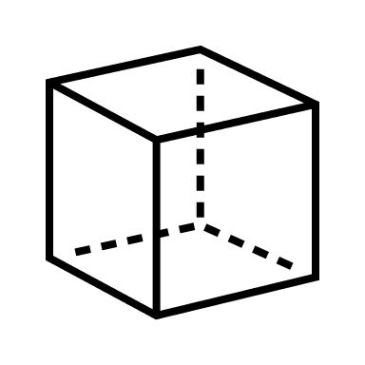


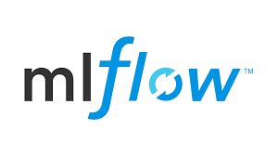


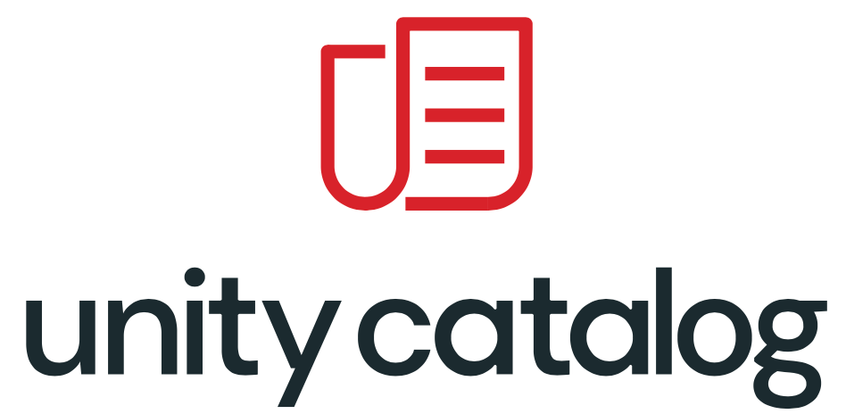
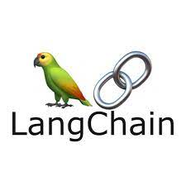
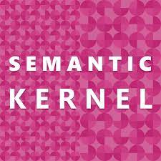

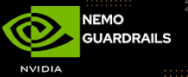









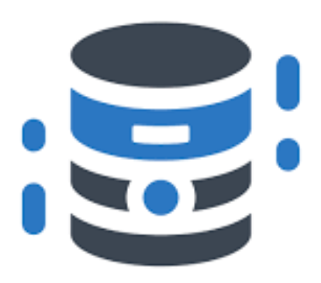







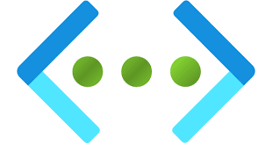


Reference Architecture Pattern for GenAI with RAG on Azure Databricks
SW’s Azure Databricks account
Continuous Monitoring
Model Catalog
Azure Databricks Workspace
MosaicAI
14
Databricks hosted Models
HuggingFace Hub
Models
Evaluate Flows
Embedding Models
13
Monitor & log
B
Monitor / Modify Flow
Register & Deploy
Generate query embedding
3
2
1
Continuous Monitoring
Model
Endpoints
4
Verified query
Input / Output Guardrails
Query
Query
MosaicAI
Embedded query
Orchestrator
Model Serving Rest API
Databricks
Model Serving
Prompt: Context + Query + Instruction
7
Generated response
9
11
Business Users / Apps
Generated response
Guardrails
8
Verified generated response
Verified
generated
response
Inference / Metric Tables
User / App feedback
Semantic cache search
5
10
12
SW Azure subscription
6
Return ranked response
Save to
Semantic Cache
A
Azure Cognitive
Services
Value & Vector Similarity search based on query embedding
SW’s Azure Databricks account
AI
Vision
Data Sources (Structured, Semi-Structured, Unstructured, Binary)
Document Intelligence
C
Guardrails
Store Query, Response and Feedback
Batch
EDP
Converts sentence to embeddings
User / App Feedback
Tables
Azure DataLake Storage Gen2
Azure Language
Chunk docs
Document loaders
Real-time
Text Chunks
Delta Table
Embedding
Raw
Cleansed
Curated
Semantic
Databricks vector db
Azure Cache for Redis
Azure Cosmos DB
Azure SQL DB
Foundational Cross Cutting Services
Identity and RBAC
Key Vault
TSL
Encryption
Network
Logging and Monitoring
Collibra
Data access
Azure AI Content Safety

Slide 18
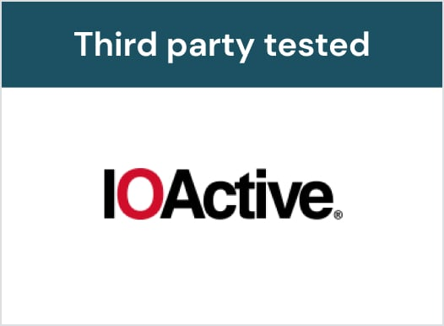
Isolation Principles for Databricks Serverless Compute
Customer workloads are protected by multiple layers of isolation
Workloads (clusters) securely isolated
No cross-workload communication
Lateral movement is blocked
Dedicated compute
Each node runs dedicated compute
Workload nodes and attached resources are wiped after use
No unnecessary inbound access
Only authenticated requests from authorized users via the control plane
Verified by independent third party pen testers with source code access
Also tested by Databricks offensive security team
18

Slide 19
There Are Multiple Layers of Isolation
Container
Workloads run in an unprivileged container
Disks
All local and attached disks are dedicated to a customer & wiped after use
All disks are temporary & encrypted at rest
Compute
Dedicated to a customer & wiped after use
No privileges or credentials for other systems
Network
Each workload / cluster is on an isolated logical network
No public IP addresses
No ingress allowed from other workloads / clusters
Container
Disks
Compute
Network

Slide 20




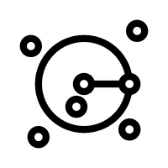
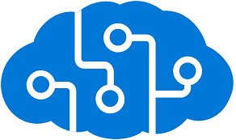



Gen AI with RAG on Azure
Agent User
Data Mgmt. & Ingestion
Chunks
Volume
Ingest Files / Data
Query
Response
Delta Tables
Chunks, features, embeddings
Files
Sydney Water
(Azure Australia-East)
Content& Prompt Engineering
Import Doc, Chunk Doc, Extract Text, Tables, Create Embeddings
2
3
3b
3b
Logs & Monitoring
Azure Apps Insights
Vector
Azure App Service
Sync
Python Libs
5 Semantic Search
3a Create Embeddings
6 Top Match(es)
7
Prompt: Context + Q + Instruction
Azure Form Recognizer
Cosmos DB for Mongo DB
Response
Microsoft Compute
(Azure Australia-East)
Azure
OpenAI
Plugins
Azure OpenAI o4
Models Deployed in SW Tenancy
Prompt

Slide 21
Gen AI with RAG on Azure – Logical Architecture

Slide 22
Architecture Principles
Architecture Consideration | Pattern to be applied
User interface and end point security (MFA, B2C, SSO, CASB, PAM) | As per the existing SSO, MFA standards and policies of Sydney Water
Data security (Encryption, Protection, Segregation, Access Control, DLP) | As per the existing encryption, protection, segregation, access controls of Sydney Water’s Azure Tenancy
Network Security (Firewall, IDP, SSL, Encryption, Segregation) | As per the existing firewalls, SSL, encryption, segregation policies of Sydney Water
Infrastructure security (Anti-virus, Access Control, Hardening) | As per the existing Sydney Water’s Azure tenancy policies and standards
Integration security (SSL, VPN, Encryption, Access Control, Protection) | As per the existing Sydney Water’s integration security policies
Application security (user role management, Rights management, segmentation and segregation) | As chatbot application will adopt existing Azure SSO authentication and RBAC policies. In addition, application will have specific personas to address the data segregation based on the department and level of access.

